Slide 1
Artificial Intelligence for Games Week 2 – AI Architecture Steve Rabin
For help on projects, email everyone (select and copy this string from the start of any class PowerPoint):
steve.rabin@gmail.com, p.jiankai@digipen.edu, b.hsu@digipen.edu, zak.s@digipen.edu, keaton.sullivan@digipen.edu, john.tseng@digipen.edu, a.roulst@digipen.edu
TAs: Jian Kia Phua, Brandon Hsu, Zak Stephenson, Keaton Sullivan, John Tseng, Andrew Roulst

Slide 2
Questions
What AI architecture came out of Halo 2?
What AI architecture came out of F.E.A.R.?
What AI architecture came out of The Sims?
What game inspired Interactive Storytelling?
What are 4 interesting AI aspects in Pac Man?

Slide 3
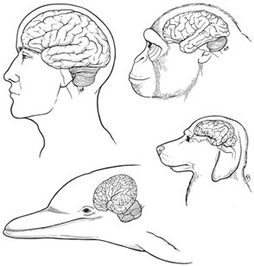
Common AI Architectures

Slide 4
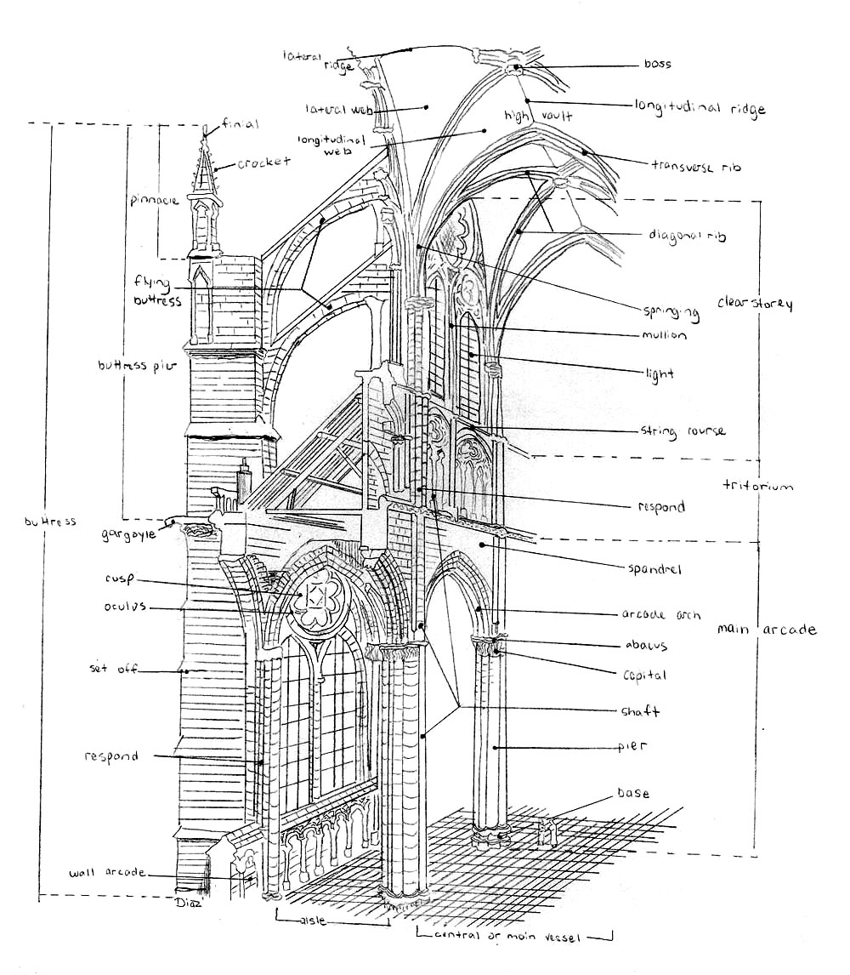
Common AI Architectures
Scripting
Finite-State Machine
Behavior Tree
Rule-Based
Utility-Based
Planning

Slide 5
AI Architecture Terminology
Options
Options are the actual AI behavior (like Attack)
“Which option will the AI choose?”
Reasoners
Reasoners choose which Option to execute
“An AI agent reasons as to which option to choose.”

Slide 6
Programming Paradigms
Machine Code
Procedural Programming (C, Basic)
Object-Oriented Programming (C++)
Declarative Programming
Functional Programming (Lisp)
Domain-Specific Languages (make, HTML)
Constraint Programming (various)
Logic Programming (Prolog)

Slide 7
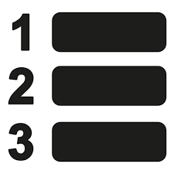

AI Architecture Terminology
Procedural Architecture
Programmer specifies all behavior and contingencies
Reasoners/Options are explicitly programmed
Declarative Architecture
Programmer gives AI goals or priorities
Has no “control flow”
Important considerations are “declared”
Options are chosen dynamically by Reasoner

Slide 8
Scripting
Procedural architecture
Similar to procedural programming
Specified “control flow”
Basic C-style programming
Loops
Sequence of instructions
Conditional options

Slide 9
Scripting
Domain Specific Language (DSL)
Simple language that solves a very specific problem
Can be simple enough for non-programmers
Trigger System
Example of a DSL
Simple, constrained, and robust scripting system
Easy to understand, allowing even players to author

Slide 10
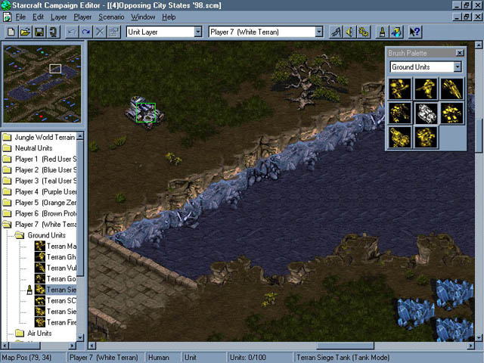

Slide 11
Scripting
Custom Scripting Languages
Starts out as a DSL
Grows into a monster and becomes hated
Why are they hated?
What’s the benefit?

Slide 12
Custom Scripting Languages
ID Software: QuakeC
Quake series, Doom 3, games that use Quake Engine
Epic Games: UnrealScript
Unreal Tournament and games that use Unreal Engine
BioWare: NWscript
Neverwinter Nights
Lucas Arts: SCUMM (Script Creation Utility for Maniac Mansion)
50+ games

Slide 13
Custom Scripting Languages
Maxis: Simantics
The Sims, The Sims 2
Gas Powered Games: Skrit
Dungeon Siege, Dungeon Siege 2, Supreme Commander
WizBang Studio Productions: Adlib
Activision's HyperBlade, Microsoft Baseball series
Naughty Dog: GOAL (Goal Oriented Action Language)
Crash Bandicoot series and Jak and Daxter series
Zero Engine: Zilch

Slide 14
Scripting
Level 0: Hardcode everything in a compiled language (C/C++)
Level 1: Data in files specify stats/locations
Level 2: Scripted cutscene sequences
Level 3: Lightweight logic specified by tools or scripts
Trigger system
Level 4: Heavy logic in scripts that rely on core C/C++ functions
Level 5: Everything coded in scripts
Full alternative language to C/C++ (GOAL)

Slide 15
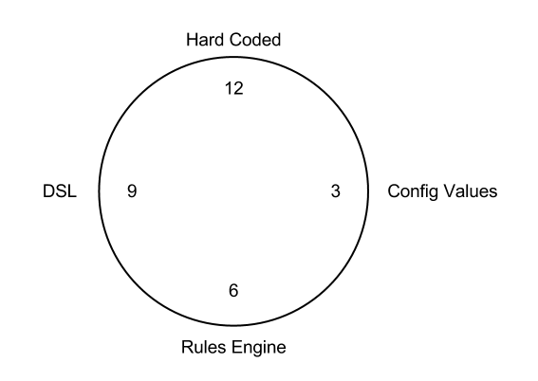
Configuration complexity clock
http://mikehadlow.blogspot.com/2012/05/configuration-complexity-clock.html

Slide 16
Scripting
Lua and C# have won!
Lua most commonly integrated language
C# most used due to Unity
MonoGame: C#
But are they really scripting languages?
What’s the benefit?
How do they get those benefits?

Slide 17
Finite-State Machine
Procedural architecture
States are the options
Transitions are the reasoner
Conditions under which to change states

Slide 18
Finite-State Machine
Models cyclic behavior extremely well
Excellent for simple behavior
Fewer states is better
Brittle, hard to modify

Slide 19
Hierarchical Finite-State Machine
HFSM is modular and scales better
Dead
Alive

Slide 20

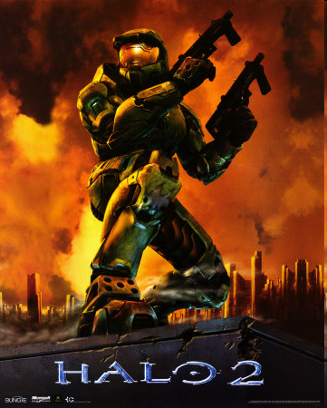
Behavior Trees
Popularized by Damian Isla at GDC 2004.
Halo 2 had 50 different behavior trees.

Slide 21
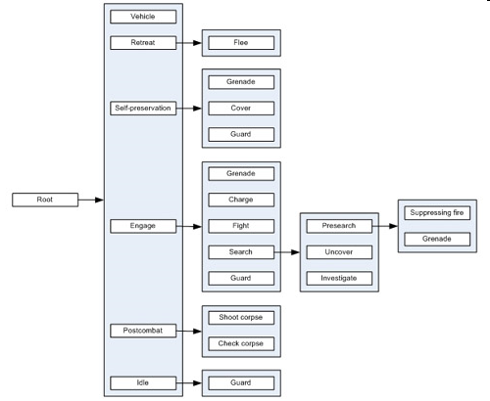
Behavior Tree

Slide 22
3 types of nodes
Control Flow
Decorator
Action
Action
Control Flow
Which are Reasoners?
Which are Options?
Action
Action

Slide 23
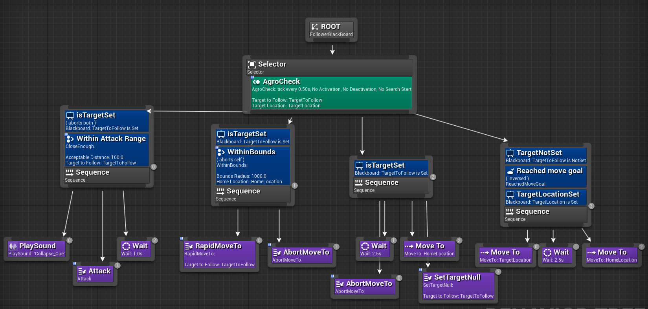
Unreal Engine

Slide 24
2 primary control flow nodes
Selector
Sequence
Action 1
Action 2
Action 3
Action 1
Action 2
Action 3
Fixed Prioritized List of Actions
Fixed Plan

Slide 25
2 primary control flow nodes
Selector
Sequence
Plan A
Plan B
Plan C
Step 1
Step 2
Step 3
Fixed Prioritized List of Plans
Fixed Multi-step Plan
Behavior trees are really great at representing fixed plans

Slide 26
Use random versions when order doesn’t matter
Rand Selector
Rand Sequence
Action 1
Action 2
Action 3
Action 1
Action 2
Action 3
Actions have no priority
Plan has no order

Slide 27
Parallel node runs all at the same time
Success Policy A: Succeed if any succeed.
Success Policy B: Succeed after N have succeeded.
Success Policy C: Succeed after all have succeeded.
Failure Policy A: Fail if any fails.
Failure Policy B: Fail after N have failed.
Failure Policy C: Fail after all have failed.
Parallel
Action 1
Action 2
Action 3
Run all simultaneously

Slide 28
Decorator is a condition/modifier
Precheck decorators
Selector
Postcheck decorators
If (condition)
Run 3x
If Target Selected
Always Succeed
If Target >= X meters
Always Fail
Decorator
Run <= X Times
Invert Succeed/Fail
Action 1
Action 2
Action 3
Run After Cooldown
Rerun until Success
Restrict Simultaneous
Rerun until Fail
Store Value in Blackboard
Debug Breakpoint
Log Data for Debug

Slide 29
Service will poll and steal control
Every X seconds
check condition.
If true, restart here.
Selector
Service
Every 0.2 seconds
check if < 10% health.
If true, restart here.
Every 0.1 seconds
check if aggro,
If true, set target
and restart here
Action 1
Action 2
Action 3

Slide 30
Selector
1
2
3
4

Slide 31
Decorator

Slide 32
Sequence
1
3
2

Slide 33
Leaves (Actions)

Slide 34
Service

Slide 35
Blackboard

Slide 36
Cycles?

Slide 37
Interruptions?

Slide 38
Static Plan
(hierarchical + modular +
designer friendly)

Slide 39
Sequence
Enemy visible?
Write to enemy ID to blackboard
Selector
Engage Enemy in Blackboard
Sequence
Always Succeed
Is high ground nearby?
Move to high ground

Slide 40
Sequence
Always Succeed
Enemy visible?
Write to enemy ID to blackboard
Sequence
Engage Enemy in Blackboard
Is high ground nearby?
Move to high ground

Slide 41
Sequence
Always Succeed
Enemy visible?
Write to enemy ID to blackboard
If high ground nearby, move there
Engage Enemy in Blackboard

Slide 42
What is the problem with this Behavior Tree?
Selector
If Enemy
Sequence
Attack
Goto A
Goto B

Slide 43
What is the problem with this Behavior Tree?
Selector
Blackboard
Target = null
Check every 0.1s if no target. If enemy set Target.
If Target set
Sequence
Attack
Goto A
Goto B

Slide 44
If the Service node does not exist, how can you get
the Service node behavior using Parallel?
Selector
If Enemy
Parallel
Parallel Policy:
Succeed if any succeed.
Fail if any fail.
Attack
Sequence
Rerun until Success
If Enemy
Goto A
Goto B
Always Succeed

Slide 45
Behavior Tree
Control Flow
Procedural architecture
Meta-architecture
Nodes can hold any architecture
Modular
Represents a fixed plan
Cyclical but not obvious
Poor at interruption returning
Poor at state-based / modes
Service
Decorator
Action
Action
Control Flow
Action
Action

Slide 46

Rule-Based
Declarative architecture
Sequence of condition-option pairs
Evaluates each condition in order
If condition is “true” then select that option

Slide 47
Rule-Based
FPS Character Example
Rule 1: If health is low, then Flee
Rule 2: If out of ammo, then Reload
Rule 3: If player in sight > 1m, then Shoot
Rule 4: If player in sight <= 1m, then Punch

Slide 48
Utility-Based
Declarative architecture
Each option gets scored by a heuristic reasoner
Score is a float
Also known as a weight, priority, or utility
FPS Example
Flee: 0.30 utility
Reload: 0.10 utility
Attack: 0.60 utility

Slide 49
Utility-Based
FPS Example
Flee: 0.30 utility
Reload: 0.10 utility
Attack: 0.60 utility
Choose an option
Highest score
Weighted random

Slide 50

Utility-Based
Score is likely to be subjective
Do I want:
$4.99 cat toy – 2 days to be delivered
$2.99 cat toy – 5 days to be delivered

Slide 51
Expected Utility
Utility Scores are Normalized: [0, 1]
Makes scores comparable
Expected Utility
Utility * Probability
Maximum Expected Utility
Choose one with highest Expected Utility

Slide 52

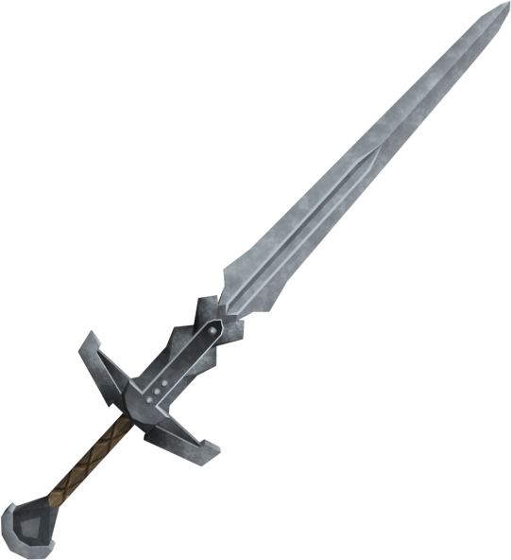
Expected Utility
Attack with dagger
Utility: 0.4
Probability of hit: 95%
Attack with dagger: 0.4 x 0.95 = 0.38
Attack with two handed sword
Utility: 0.9
Probability of hit: 60%
Attack with sword: 0.9 x 0.60 = 0.54

Slide 53
Planning
Declarative architecture
Two common types
GOAP (Goal-Oriented Action Planning)
HTN (Hierarchical Task Network)
Planning search algorithm is the reasoner
Actions or tasks are the options

Slide 54
Planning
Goal: Enemy Dead
Search for a sequence of actions
Transform the “Current State of the World”
into a “Goal State of the World”
Replan if the goal changes
If near death, then replan with “Don’t Die” goal

Slide 55
Planning
Goal: Rabin is a billionaire
Search for a sequence of actions
Transform the “Current State of the World”
into a “Goal State of the World”
Replan if the goal changes
If charged with fraud,
then replan with “Don’t Go to Jail” goal

Slide 56

Review
Scripting
Finite-State Machine
Behavior Tree
Rule-Based
Utility-Based
Planning
Procedural
Declarative
Options
Reasoners

Slide 57

Architecture Power Design Patterns
Modularity
Option Stacks
Hierarchical Reasoning
Knowledge Management
Blackboard Architecture
Intelligent Everything

Slide 58
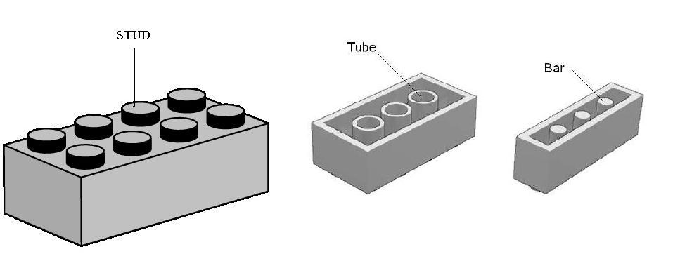
Modularity
Traditional software design pattern
Small reusable chunks with a consistent interface
Component architectures
Consider making a target into a modular object
Options frequently need a target

Slide 59

Modularity Action option needs a target
Target could be a character, position, or the camera
Target could be the output of a reasoner
Select the closest enemy
Modular target decouples specifying and updating target from actions that use it
A distance consideration can compare two targets without caring what types they are
Targets could be stored in a blackboard

Slide 60

Option Stacks
AI can be interrupted by high priority options
Returns to interrupted option when done
New option is placed on stack and executed
When done, option is popped, old option resumes

Slide 61
Option Stacks
Example
Patrolling perimeter
Sees enemy and attacks
After enemy dead, return to patrol
Also known as a
State stack, or Goal stack,
Alternative architecture: Subsumption

Slide 62
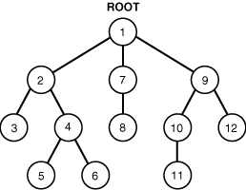
Hierarchical
Scalability is a huge problem
Hierarchical reasoning is the fix

Slide 63
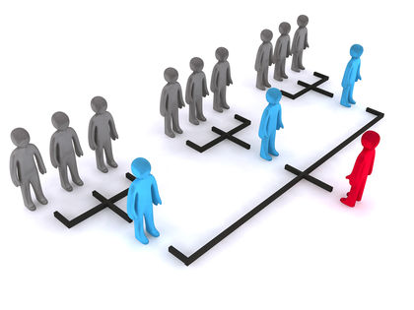
Hierarchical
FSMs become HFSMs
HTN for planners
Behavior Trees
Strategy game AI
General, Platoon, Squad, Soldier
Hierarchical Pathfinding

Slide 64
Knowledge Management
Blackboards
Knowledge Everywhere

Slide 65

Knowledge Management: Blackboards
Store data in communal places
Store data in the terrain or shared data structures
Store expensive checks (LOS or pathing)
Coordinate AI characters

Slide 66

Knowledge Management: Intelligent Everything
Store intelligence in objects and the world
Popularized by The Sims
Smart objects
Smart terrain

Slide 67
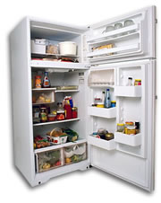
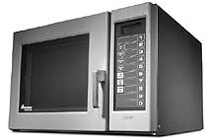

Smart Terrain / Objects
Characters have needs and motivations
Objects satisfy those needs

Slide 68
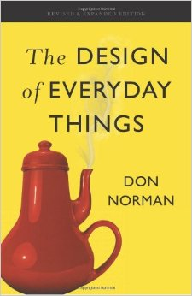
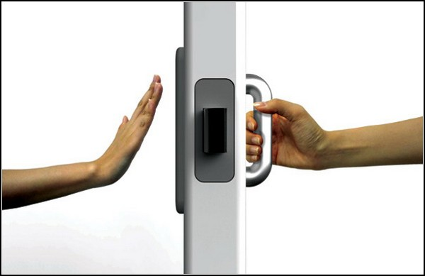
Smart Terrain / Objects
Object instructs agent on use
What does the object offer (broadcasts it)
How to use the object (instructions, animations)
Similar to an affordance
Design of Everyday Things

Slide 69

Person
Data
- Needs
- Personality
- Skills
- Relationships
Motive Engine
Skills
- Cooking
- Mechanical
- Logic
- Body
- Etc
Personality
- Sloppy to Neat
- Shy to Outgoing
- Serious to Playful
- Lazy to Active
- Mean to Nice
Physical
- Hunger
- Comfort
- Hygiene
- Bladder
Mental
- Energy
- Fun
- Social
- Room

Slide 70

Person
Stats
-20 Hunger
-12 Comfort
-30 Hygiene
-75 Bladder
+80 Energy
+40 Fun
+10 Social
-60 Room
Mood +18
Toilet
Mood+26
Urinate (+40 Bladder)
Clean (+30 Room)
Unclog (+40 Room)
Bathtub
Mood +20
Take Bath (+40 Hygiene, +30 Comfort)
Clean (+20 Room)

Slide 71
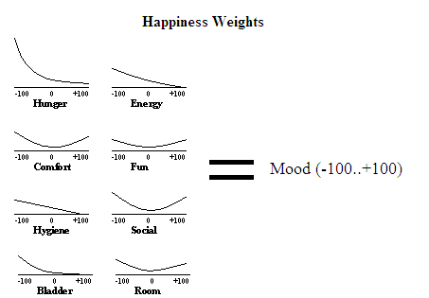
Happiness Weights

Slide 72
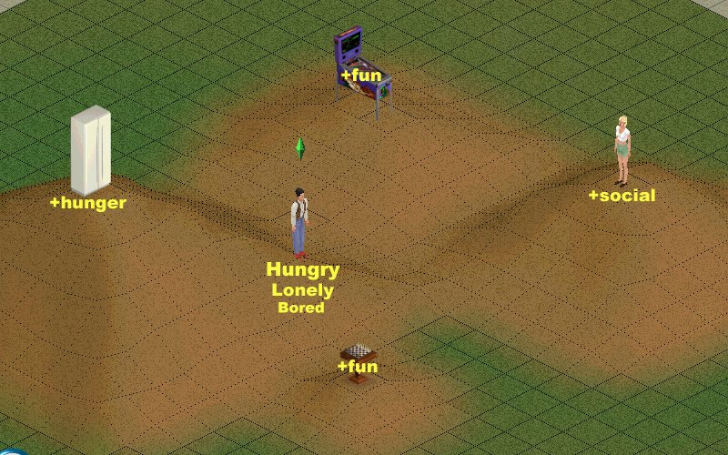
“Happyscape”

Slide 73
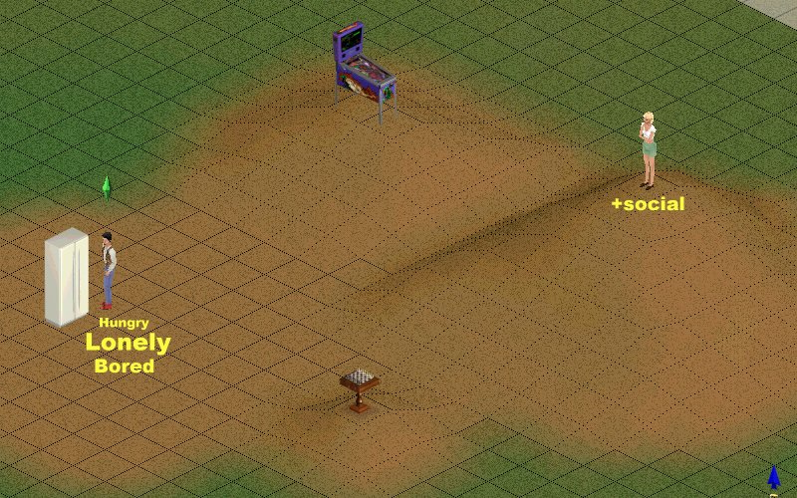
“Happyscape”

Slide 74
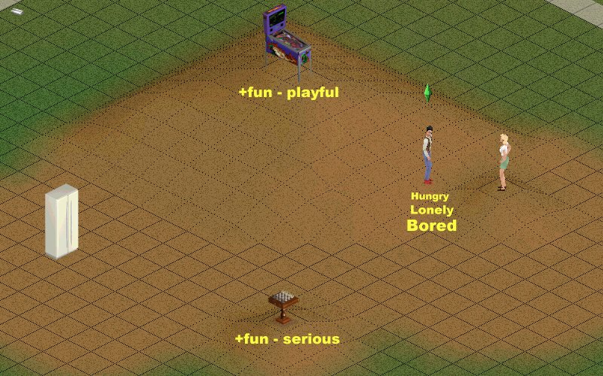
“Happyscape”

Slide 75
The AI Architecture design patterns
Modularity
Option Stacks
Hierarchical
Knowledge Management
Blackboards
Intelligent Everything

